Slide 1
Website Optimization
and beyond…..
Tom Powers / Josh Martin
Applications Team Manager / Short-timer
Southeast Christian Church
tpowers@secc.org

Slide 2
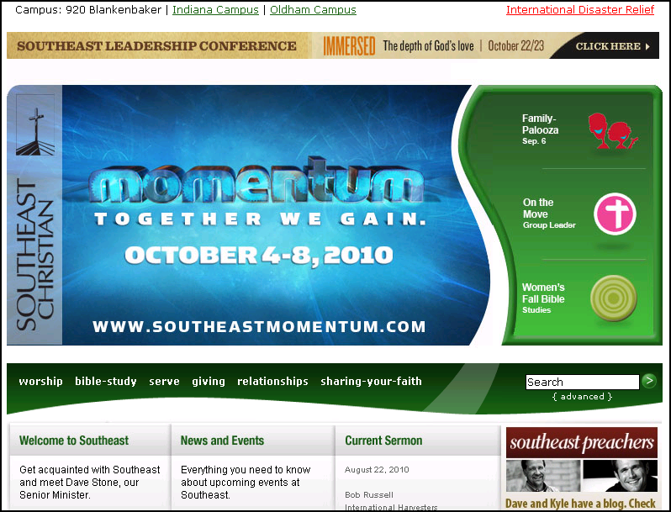
Before

Slide 3
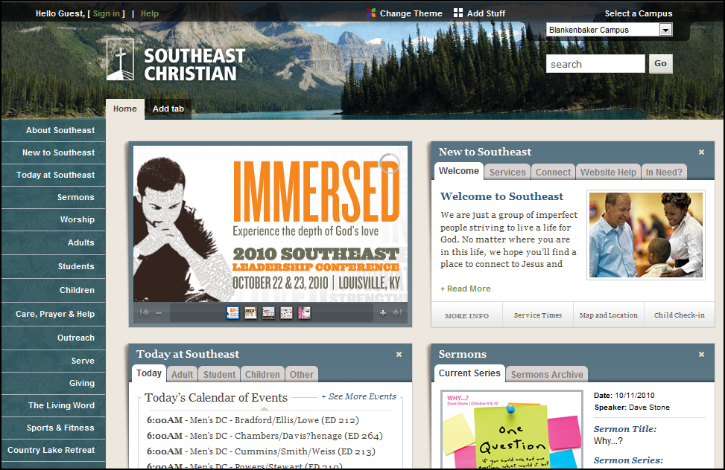
After

Slide 4

The Journey
What not to do
What to do
You are about to enter another dimension. A dimension not only of sight and sound, but of mind. A journey into a wondrous land of imagination. Next stop, the Twilight Zone!

Slide 5
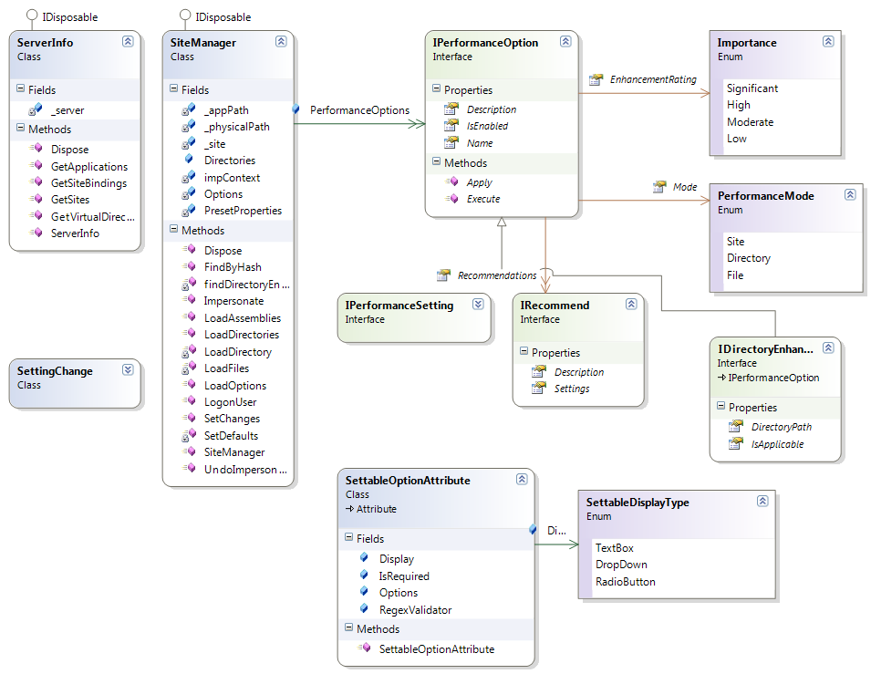
Performance Framework

Slide 6
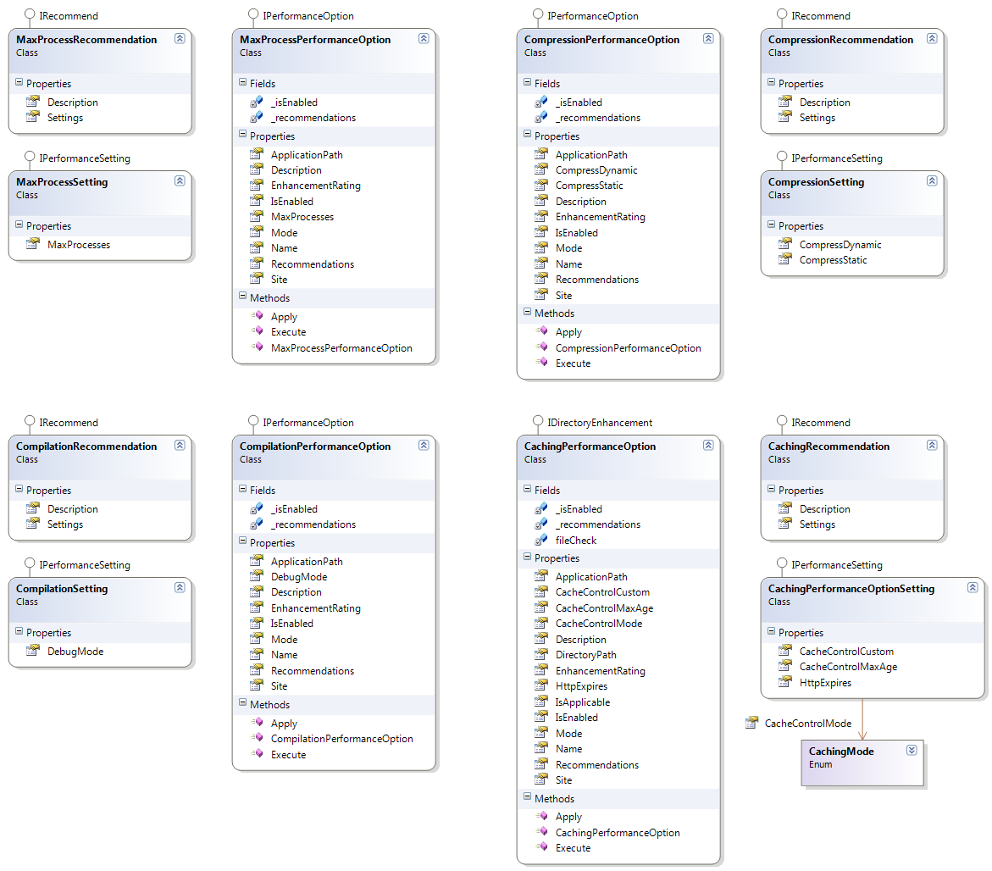
Class Diagram

